Slide 1
SABO Garbage Collection Trolley

Slide 2
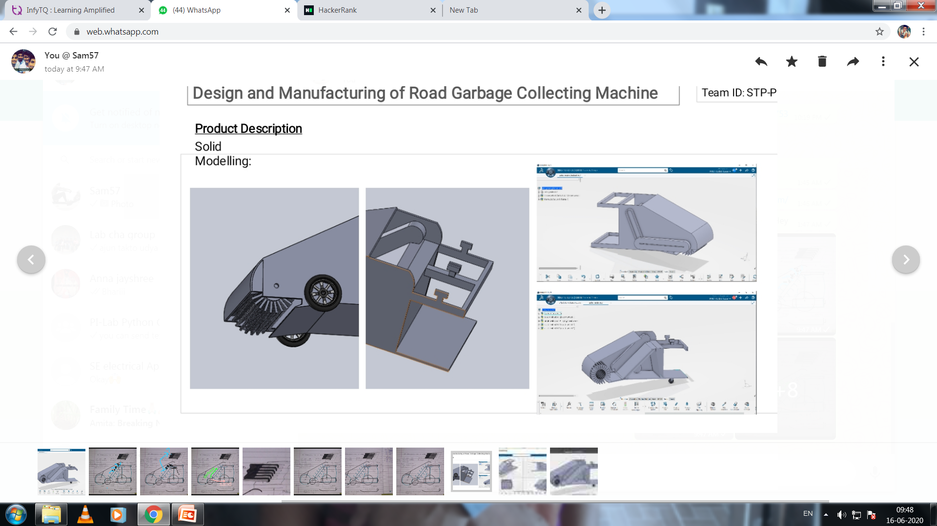
Model 1.0
Primary design shown at Dassault Systems

Slide 3
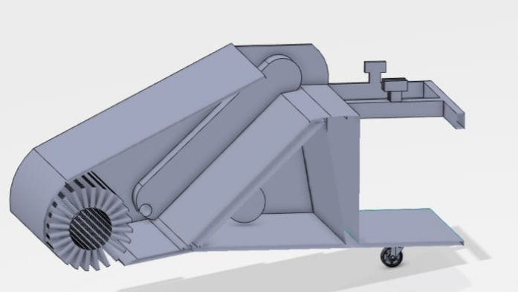
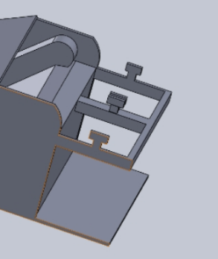

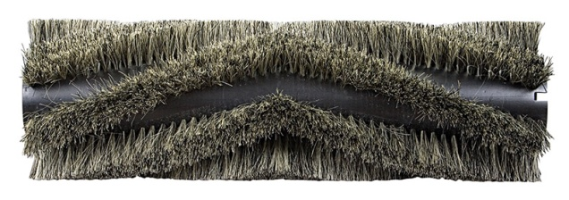
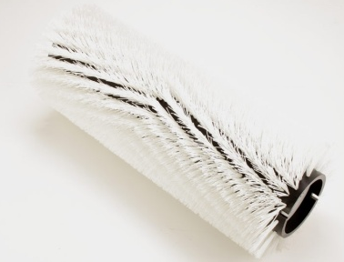
Conveyor for lifting garbage to pre-collection area
Operator will do manual segregation of dry garbage and wet garbage by hand with gloves
Pre-collection area
Full covered body for stopping formation of dust clouds
Path of garbage
Rotating brush that will throw garbage inside
Dry Garbage
Wet Garbage
E.T. Kapusawala shop
Contact no :9890126823

Slide 4
Space for battery and motor
Chain drive for transmission.
Gear sprockets for speed reduction

Slide 5
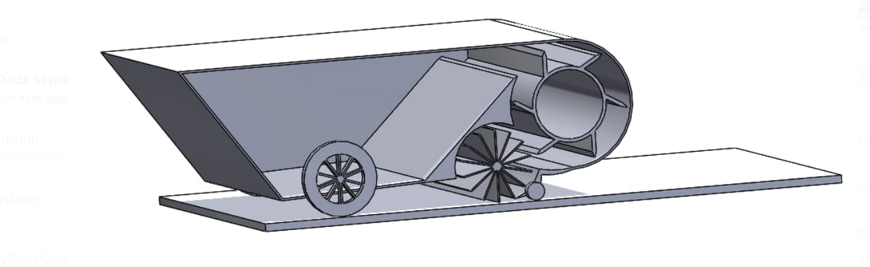
Model 2.0
Unique design for garbage collection with two Rotor system
Simple in design and Smaller in size
Less mechanical components and less cost
Easy for maintenance

Slide 6
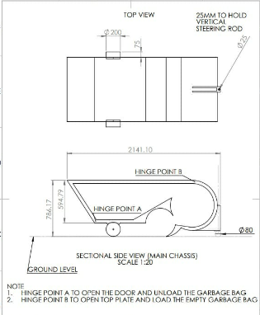
We have completed modelling and weldments for this design as we have already shared the same with you.
Also we have done calculations for brush and drum arrangement, selection of motor, speed calculations for brush and drum, chain drive transmission for achieving the same, etc.

Slide 7
Battery and motor palcement
Throw of garbage is tangential to second rotor with projectile path
Path of garbage
Two rotor system

Slide 8
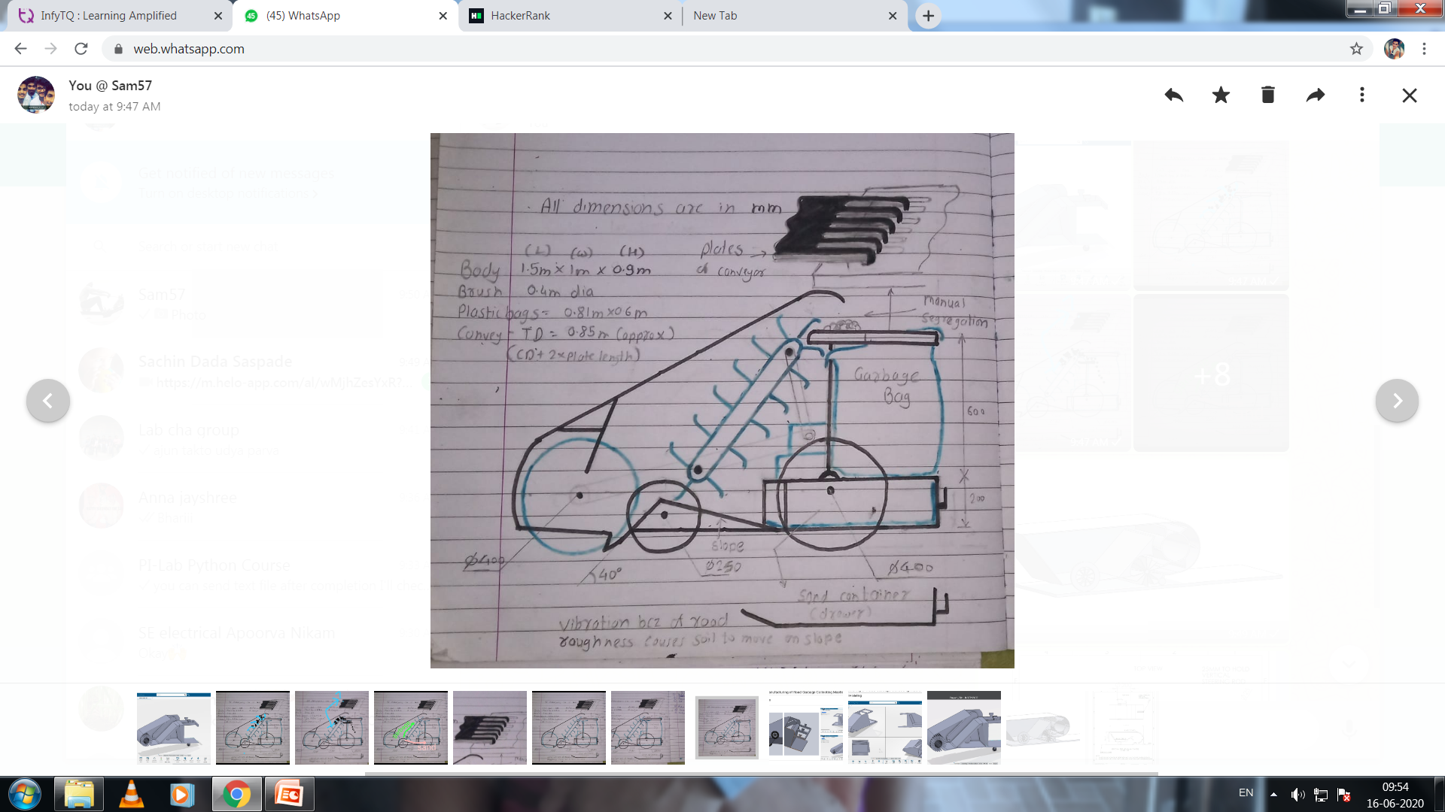
Model 3.0

Slide 9
Conveyor for lifting garbage to pre-collection area
Operator will do manual segregation of dry garbage and wet garbage by hand with gloves
Pre-collection area
Same as
model 1.0
but with
additional features
Rotating brush that will throw garbage inside
Dry Garbage
Wet Garbage
E.T. Kapusawala shop
Contact no :9890126823

Slide 10
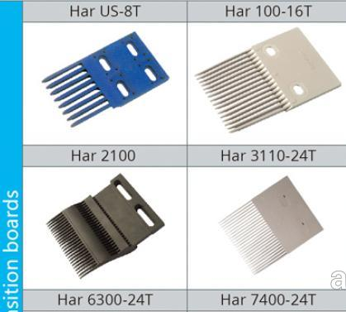
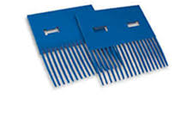
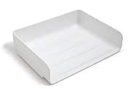
ADDITIONAL FEATURES
Conveyor transition plates with teethes which will separate sand and garbage
Comb for cleaning brush on every rotation
Vibration because of road surface roughness causes soil to move on slope
Separate sand container
Simple drawer type arrangement for removing sand

Slide 11
We have taken the decision to start working on model 3.0
We want your opinion on :
Should we continue model 2.0 as it is simple and don't have more mechanical components as Gadgil sir told during session start with simple model or we should work on model 3.0 with more features and full functionality ?
MODEL 2.0
Less features
Simple design
Parts with complex profiles
We have already completed most designing and calculation part. WE have time but there is limitation to start making prototype
MODEL 3.0
More features
Complex design than 2.0
Simple manufacturable parts
We know we have already wasted time but we can work on model 3.0 and can give you more better outcomes in upcoming days .We will update you daily .

